Slide 1
Project Title:
Design and Implementation of Multistage Marx
Impulse Generator for Testing insulators.

Slide 2
Project Guide:
Mr. S Natarajan
Team members:
Yadama Saranya
Mallavaram Sai Harini
Iyer Aishwarya Sundaram

Slide 3
Introduction:
Impulse tests are carried out in order to investigate the influence of surges in transmission lines, line insulators, transformers and other major components of a power system to confirm the withstanding capability of the insulated equipment due to external (Lightning impulse) and internal (Switching impulse) surges.

Slide 4
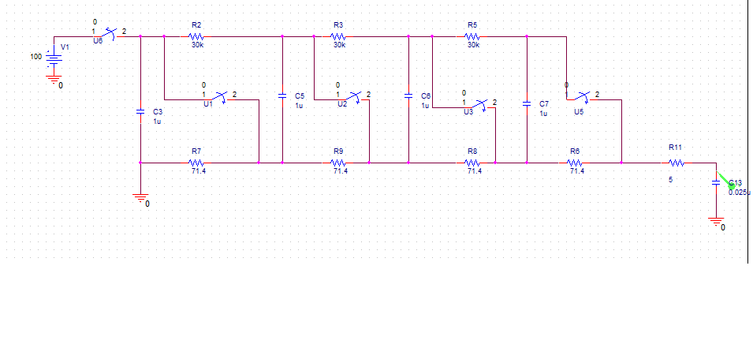
Circuit Diagram:

Slide 5
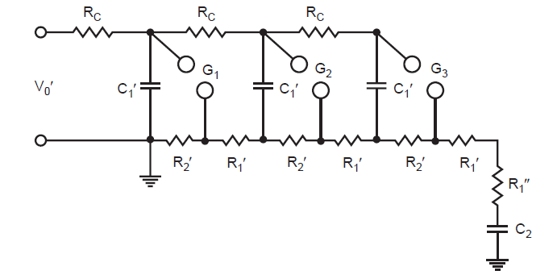
Working: Theoretical:

Slide 6
Marx generator is a device that is used to generate high-voltage pulse.
The operation of this device is based on the following principle:
The capacitors connected in parallel are first charged with electric current, and then connected in series with the help of various switching devices.
This results in the output voltage increasing in proportion to the number of connected capacitors.

Slide 7
The spark gaps used as switches have the voltage V across them, but the gaps have a breakdown voltage greater than V, so they all behave as open circuits while the capacitors charge.
The last gap isolates the output of the generator from the load, without that gap the load would prevent the capacitors from charging.
To create the output pulse, the first spark gap is caused to break down by external triggering.
The breakdown effectively shorts the gap.

Slide 8
Because of this the first two capacitors are placed in series, applying a voltage of about 2V across the second spark gap.
Consequently, the second gap breaks down to add the third capacitor to the "stack", and the process continues to sequentially break down all of the gaps.
The last gap connects the output of the series "stack" of capacitors to the load.
Ideally, the output voltage will be nV, the number of capacitor times the charging voltage, but in practice the value is less.

Slide 9
Practical:
As it is tedious to get DC supply, AC supply is used and rectified using diode.
Instead of using normal resistors we used potentiometer (POT) so that we can vary the value of resistance as a small change in the resistance value can cause significant change in rise time and fall time of the impulse voltage.
Here in Impulse Generation Circuit model spark gap is replaced by MCB so that all the capacitors are discharged at one instant.

Slide 10
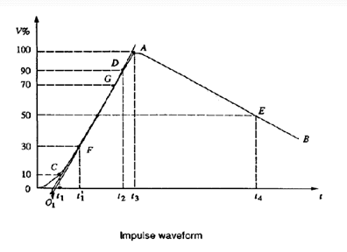
GRAPH:

Slide 11
A full impulse voltage is characterised by its peak value and its two time intervals (wave front and wave tail).
The wave front time of an impulse wave is the time taken by the wave to reach its maximum value starting from zero value. Usually it is difficult to identify the start and peak points of the wave and therefore, the wave front time is specified as 1.25 times (t2-t1) , where t2 is the time for the wave to reach its 90% of the peak value and t1 is the time to reach 10% of the peak value. Since (t2-t1) represents about 80% of the wave front time, it is multiplied by 1.25 to give total wave front time.
The wave rises to its peak value from zero in 1 microsecond and then falls to 50% of peak value in 50 microseconds.

Slide 12
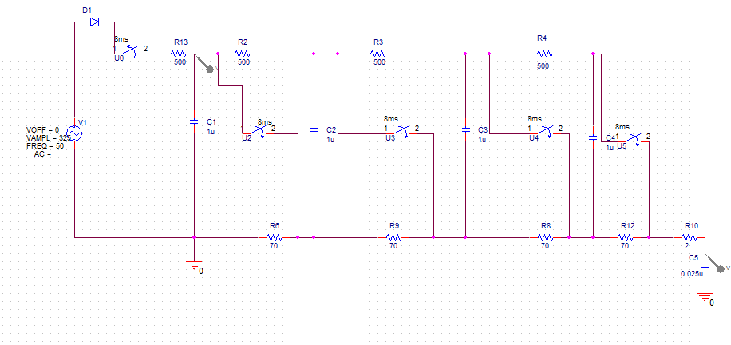
PSPICE Simulation of Four Stage Marx Impulse Generator:

Slide 13
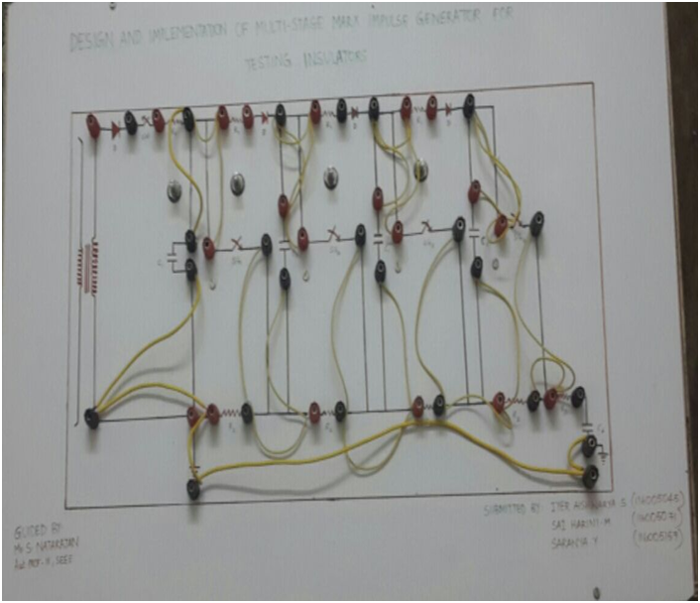
Hardware:

Slide 14
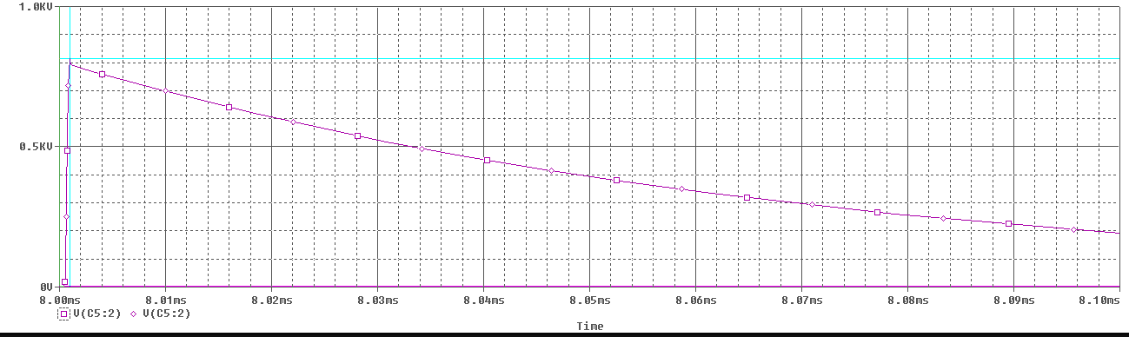
Impulse Waveform:

Slide 15
Components used:
Capacitor 1.5μF (C1) - 4 Nos. connected in parallel
Capacitor 0.1μF(C2) - 4 Nos. connected in series
POT resistance 10kΩ (R1) - 4 Nos. connected as current limiting resistor
Resistance 20Ω (R2) - 4 Nos. connected in series
Resistance 2Ω (R3) - 1 No. connected as a load
Diode (BY 127) - 4 Nos.
Connecting Wires
Probes - 2 Nos.
Soldering wire and Flux
Connecting Terminals - 43
Variac 220/480 V - 1 No.
No. of stages : 4
Input given : 100V
Output obtained : 327.4 V

Slide 16

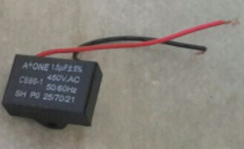
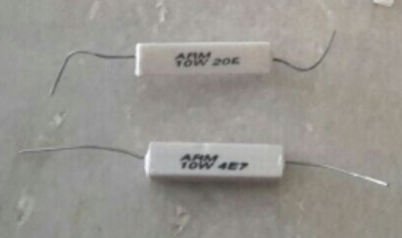
Components:
Wires
Capacitor (1.5μF )
Resistors

Slide 17



POT (10kΩ)
Diode (BY 127)
Capacitor (0.1μF )

Slide 18
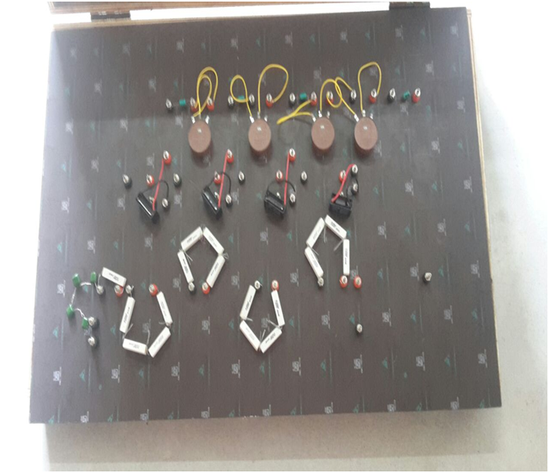
Internal Circuit:

Slide 19
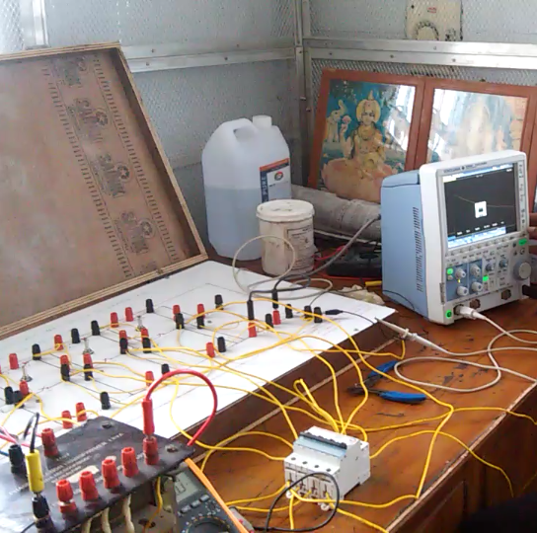
Overall Hardware connection:

Slide 20
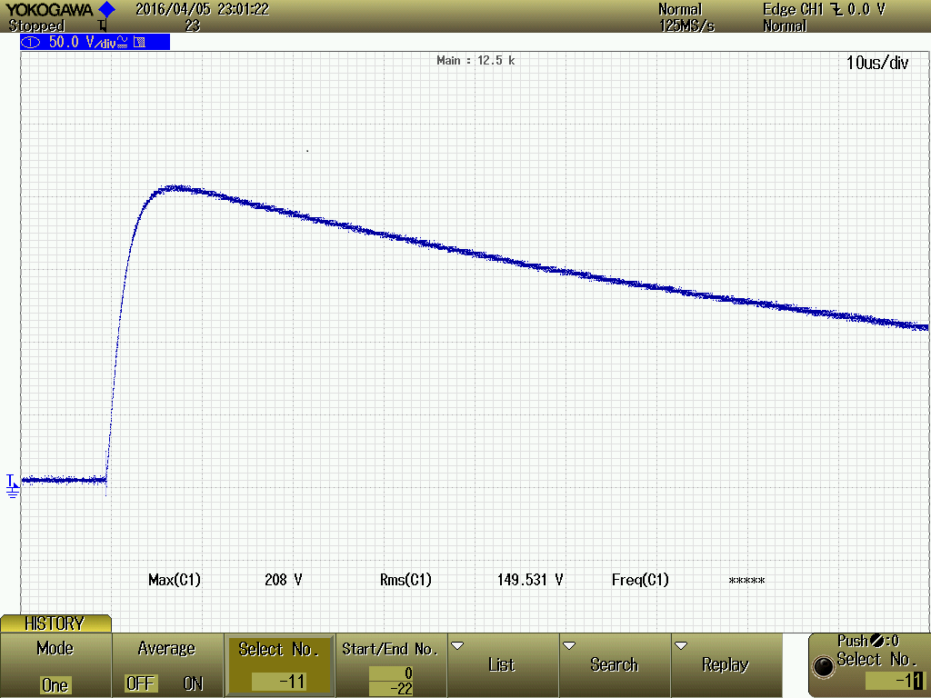
Lightning Impulse Voltage Wave for Three Stages:
InputVoltage availed from a.c mains (RMS)in Volts | No. of. Stages | Lightning impulse voltage( peak value) in Volts
60 | 3 | 208

Slide 21
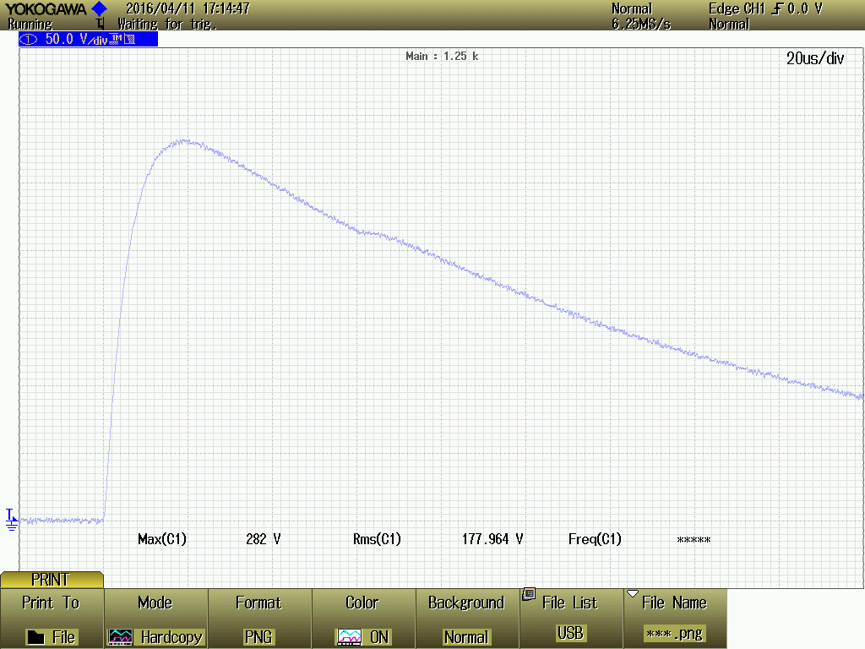
Lightning Impulse Voltage Wave for Four Stages:
Input Voltage availed from ac mains (RMS)in Volts | No. of. Stages | Lightning impulse voltage( peak value) in Volts
60 | 4 | 282

Slide 22
Observation:
More than ten numbers of samples are taken, the samples are repeatedly same wave shape and values are observed in the DSO.
While taking the samples peak overshoot is found in the output, because of manual switching instead of air gap.
The samples are taken in various scale factors.
The samples are taken by using the MCB switch.

Slide 23
Analysis:
The impulse wave shape is as per standard because the resistors and capacitors used R₁, R₂, C₁, C₂ are acceptable values.
The switching error will be corrected by using proper electronic switch.

Slide 24
Conclusion:
The generation of Lightning impulse (LI) voltage is implemented in Marx impulse voltage generator kit and also in the simulation with the PSPICE software environment.
It is found that the overall simulated result and the observed impulse voltage result from the experimental setup is close to standard impulse generator for Lightning impulse (LI)
1.2 / 50 µs wave shape for all the stages of Marx generator.

Slide 25
The wave shapes are controlled by changing stage front resistor and tail resistor. Rise time is controlled by changing stage front resistor and tail time is controlled by changing tail resistor. Peak value of each impulse wave is varied by changing initial charging of stray capacitance or current limiting resistors.

Slide 26
In this work, generation of high impulse voltage wave shape observed in the DSO. There is an oscillation in the front wave because of manual switching. This can be corrected in future by replacing an electronic switch like IGBT or SCR etc.

Slide 27
REFERENCES:
1. RamlethSheeba, MadhavanJayaraju, ThangalKunjuNediyazhikamShanavas, “Simulation of Impulse Voltage Generator and Impulse Testing of Insulator using MATLAB Simulink”, World Journal of Modeling and Simulation, Vol. 8 – 2012.
2. High Voltage Engineering by M S Naidu; V Kamaraj.
3. High Voltage Engineering by C L Wadhwa.
4. Anitya Kumar Shukla, Dr. Ranjana Singh, “Analysis of Impulse Voltage Generator and Effect of Variation in Parameters by Simulation”,
International Journal of Electrical and Electronics Research, Vol. 2, Issue 3.
5. M. Jayaraju, I. Daut, M. Adzman, “Impulse voltage generator modeling using MATLAB”, World Journal of Modelling and Simulation Vol. 4(2008) No. 1, pp. 57-63.
6. BaudilioValecillos, and Jorge Ramirez, Senior Member, IEEE, “Evaluation of Lightning Impulse Test by Frequency Response Analysis”, IEEEPES Transmission and Distribution Conference and Exposition Latin America, Venezuela.

